Slide 1

Installing GridLAB-D
This section provides instructions to install and configure your system for GridLAB-D use.

Slide 2
Downloadable Installation
Download from the web
  http://www.gridlabd.org/
Two Windows installation options
  System install: available for all users
    C:\Program Files\GridLAB-D
    Usually requires admin privileges
    Shares modules and runtime files
  Single user install: only available to you
    My Documents\My Programs\GridLAB-D
    Doesn’t require admin privileges
    Keeps libraries and runtime files private

Slide 3
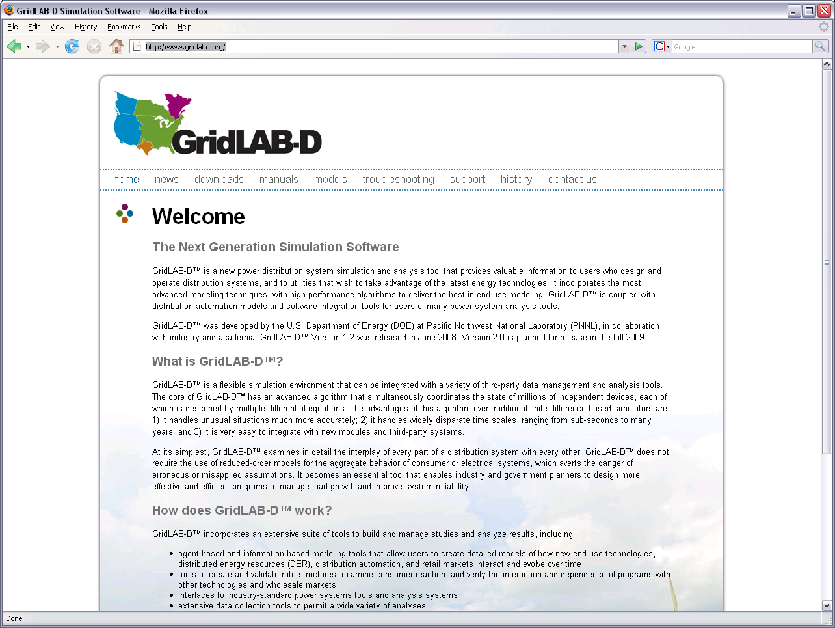

Slide 4
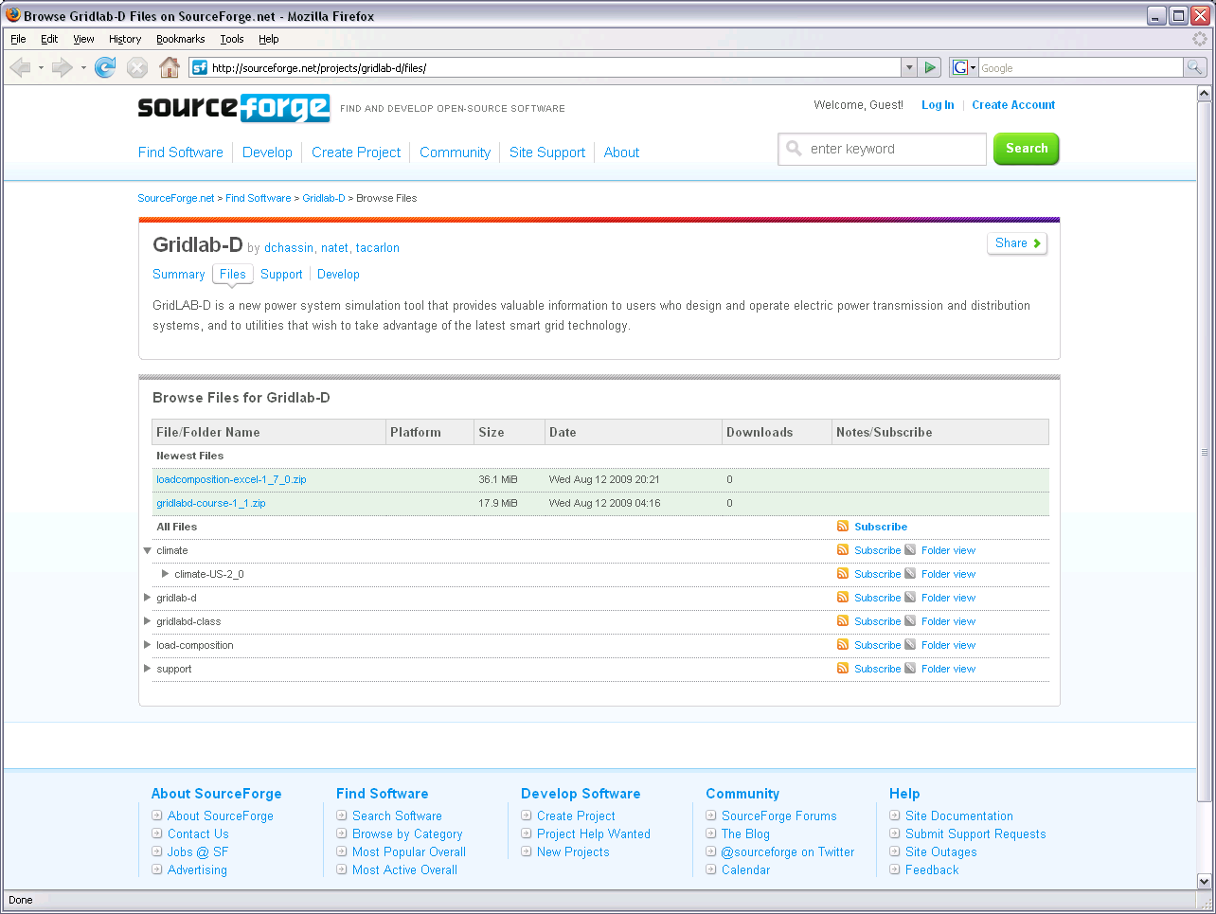
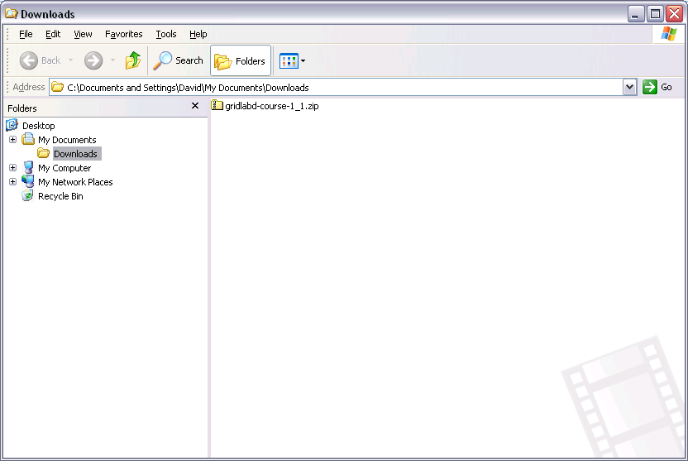
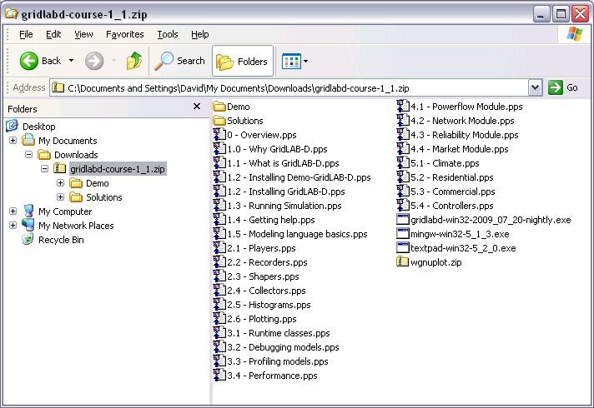
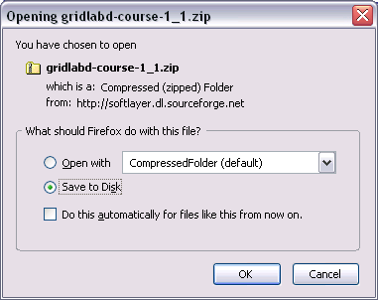

Slide 5
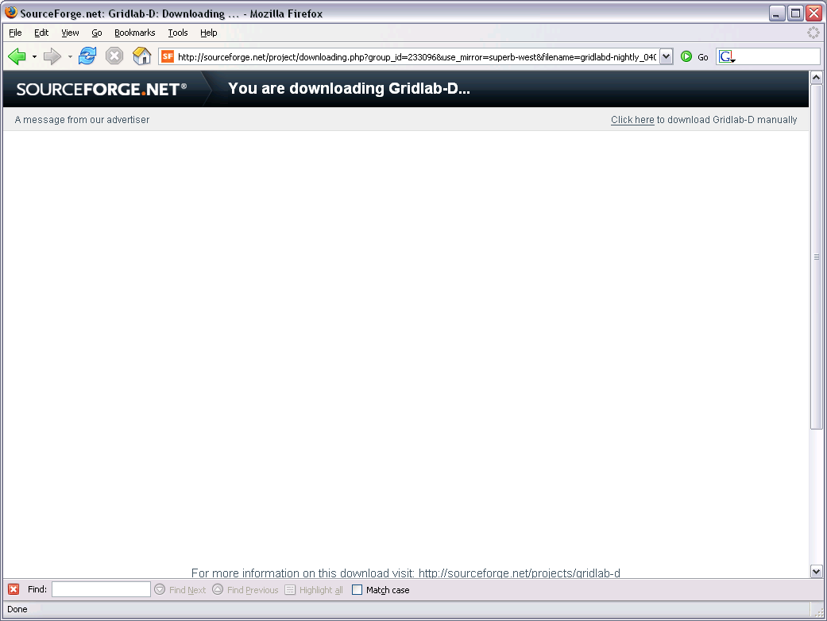
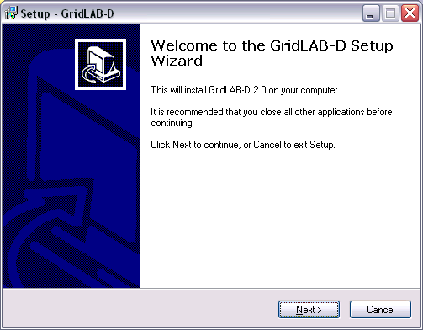

Slide 6
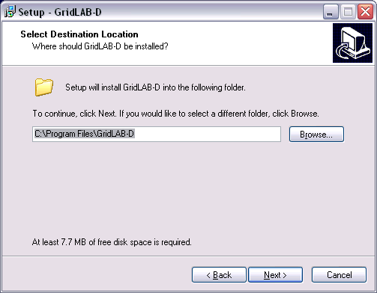

Slide 7
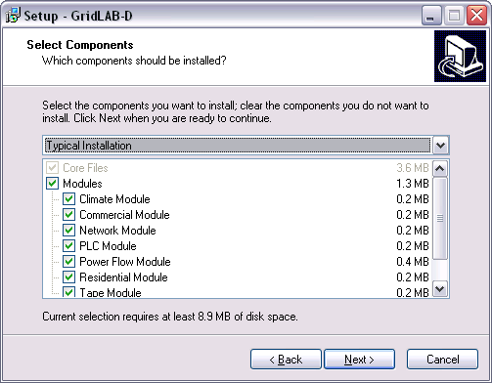

Slide 8
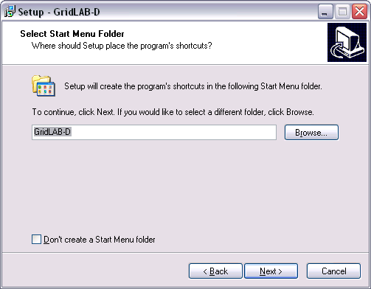

Slide 9
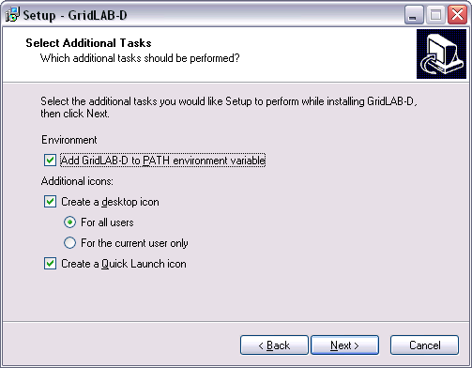

Slide 10
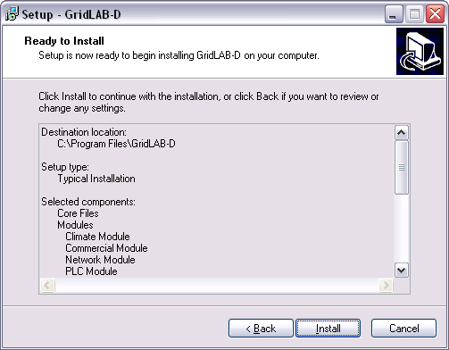

Slide 11
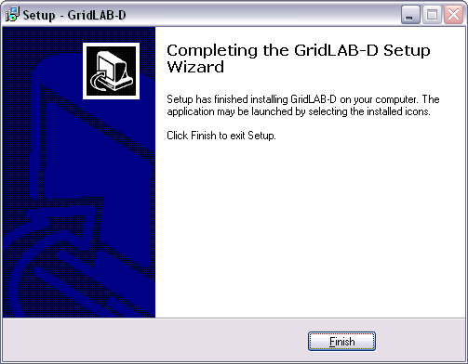

Slide 12
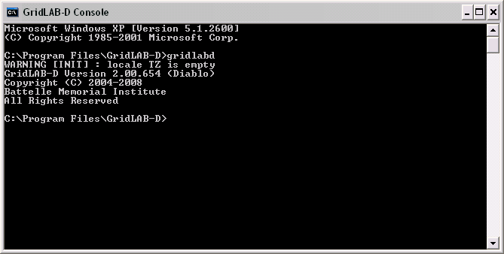
Checking your installation
StartAll ProgramsGridLAB-DGridLAB-D Console

Slide 13
Structure of Installation
…/bin – executables
  Includes gridlabd.exe
…/etc – text-based files and libraries
  Includes weather data, configuration files, etc.
…/lib – binary files and libraries
  Includes all runtime models
…/samples – sample models
Others: textpad, mingw, gnuplot, gdb, etc.

Slide 14
Windows Environment
PATH
  Specifies path to executables and modules
  Must be set before gridlabd start
  Can be modified after gridlabd starts
GLPATH
  Specifies path to libraries and runtime files
  Must be set before gridlabd start
  Can be modified after gridlabd starts
Can be changed from “My Computer”

Slide 15
Textpad install/setup
Textpad editor has helpful customizations
GridLAB-D syntax file
  Highlights GridLAB Module syntax
  Useful for detecting errors
Integrated development environment
  Can run GridLAB-D command from editor
  Gathers output and displays

Slide 16
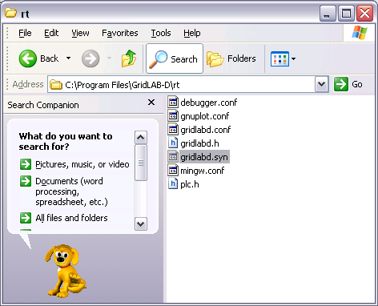
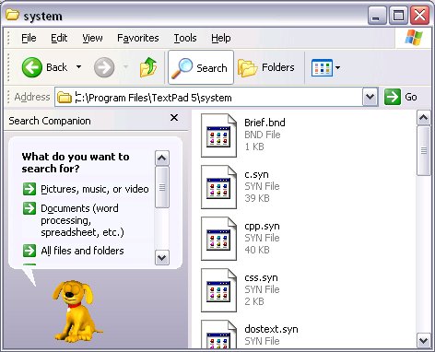
Copy Textpad Syntax Files

Slide 17
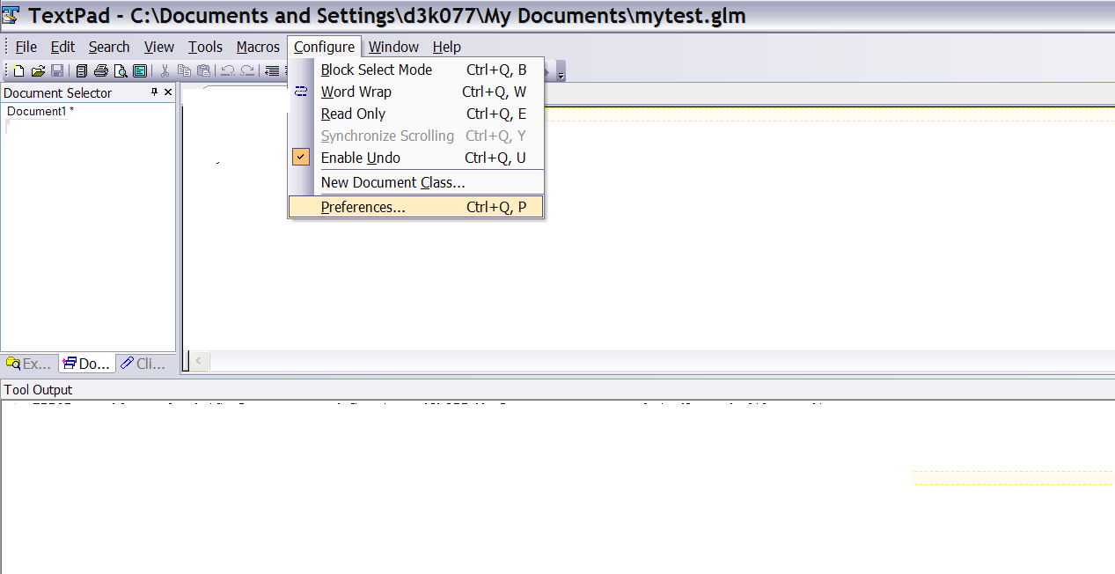

Slide 18
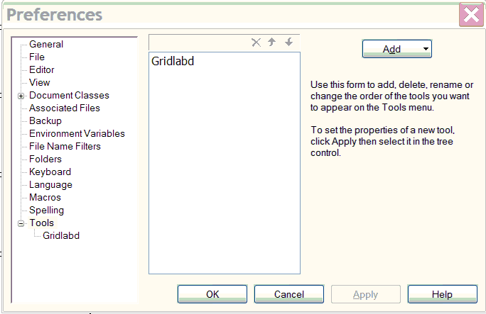
Create a GridLAB-D hotkey
Open TextPad5. Click on Configure/Preferences
Notes:
Need a print screen of TextPad and then Preferences.

Slide 19
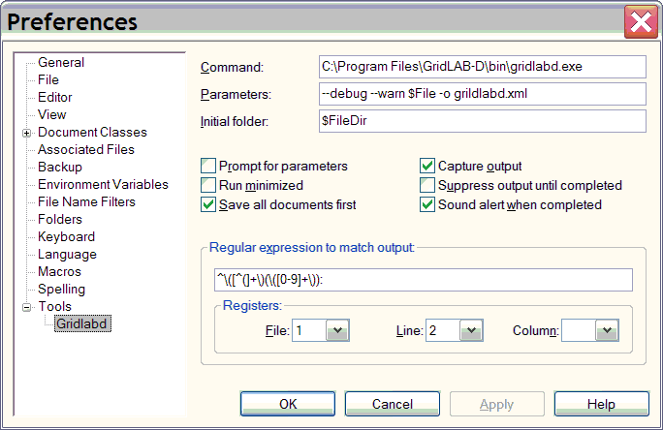
Define GridLAB-D hotkey action

Slide 20
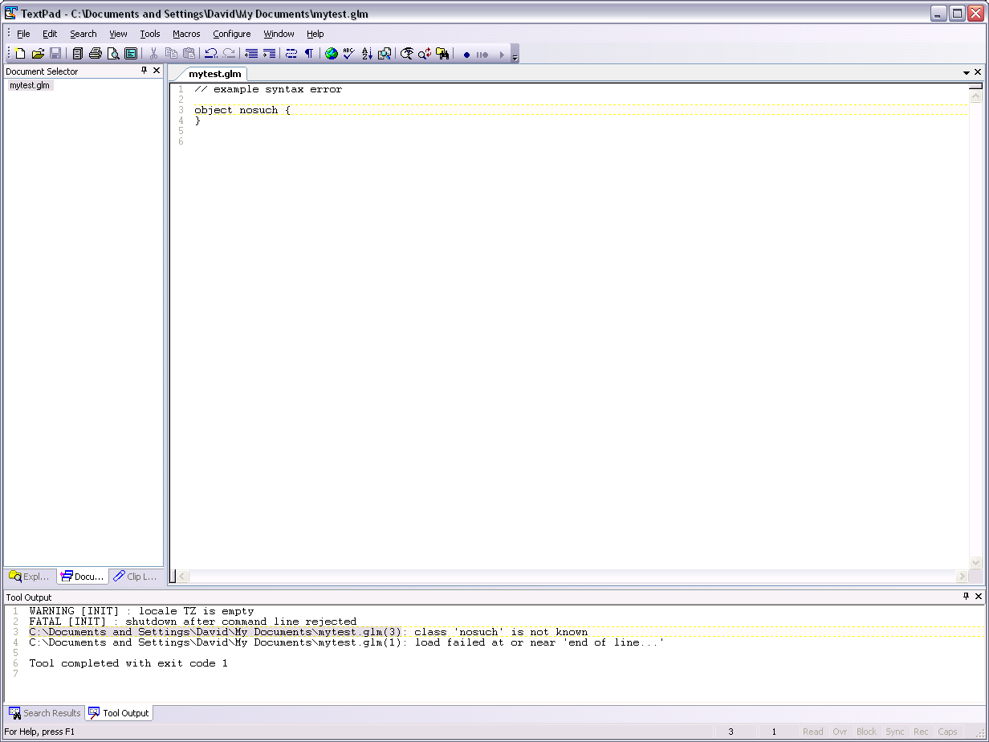
Notes:
Click

Slide 21
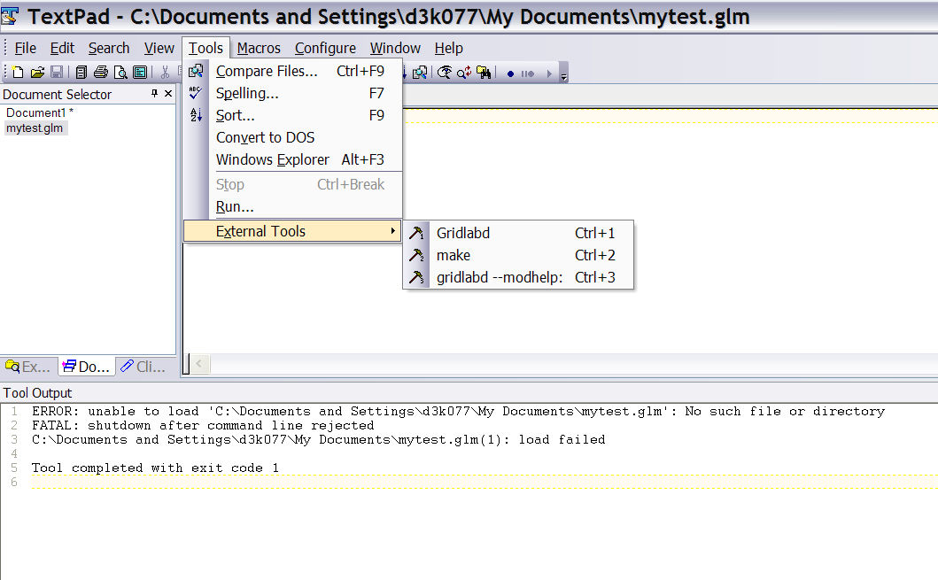

Slide 22
Exercises 1.2
Install your system and run the command:
host% gridlabd --dsttest
What happened?
Create a file with a bogus object and run it. Use the F4 key to find the error.

